Slide 1
Lecture 03
Introduction to Conventional Optimization Models (DP&LP) Part I
Notes:
https://snu-ac-kr.zoom.us/j/84027051484?pwd=aU5OZitOKzUyRW9DQ0s0TkpIMSs4UT09

Slide 2


Slide 3
Review on Lecture 02
Modeling Water Resources Systems
Models = “Simplified Representations” of the real-world systems
We use models to predict (or answer “what if” questions) possible consequences (especially quantitative) of our actions
Types of Water Resources Systems Models
Optimization, Simulation, Simulation/Optimization Models
Examples of Water Resources Systems Models
HEC-HMS, HEC-RAS, HEC-ResSim Models
Shared Vision Planning Model

Slide 4
Review on Assignment #1
23 UPH 중 가장 중요하다고 생각하는 질문?
IWRM vs Sustainable Water Resources Management
Statistics regarding worldwide water resources
4) - 5) Boryeong Reservoir Model Building
Effects on Implementation of Hedging rules: Theory and in practice?
Key assumptions inside the model you built
How to enhance model’s practicality?

Slide 5
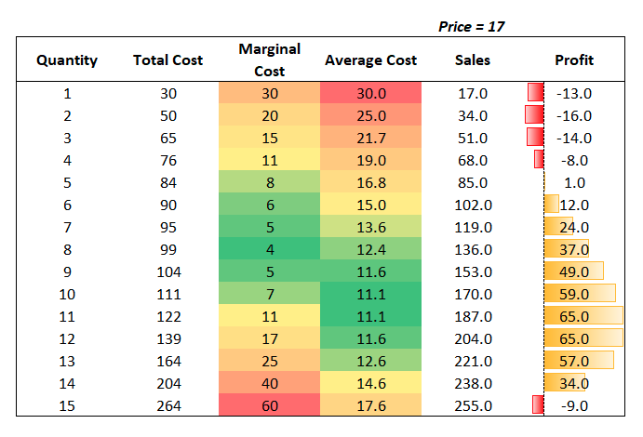
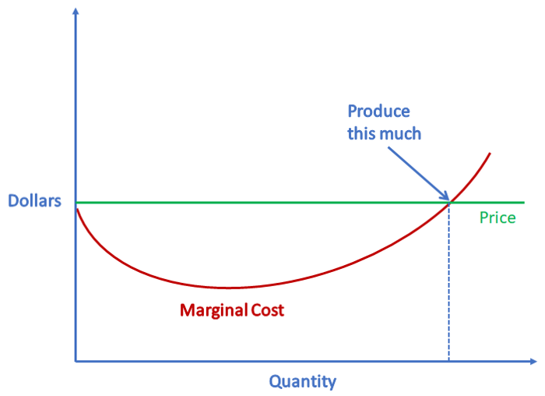
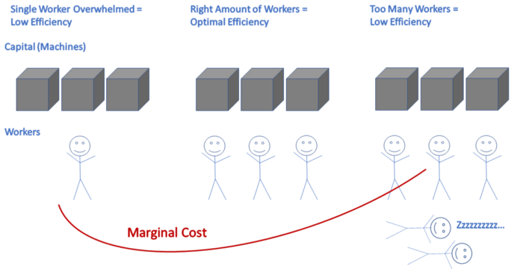
Before Lecture 03
Acronyms (약어)/Keywords in Lecture 03
DP: Dynamic Programming (동적 계획법)
LP: Linear Programming (선형 계획법)
Shadow Price (잠재 가격)
the change in the objective value of the optimal solution of an optimization problem obtained by relaxing the constraint by one unit
= marginal utility of relaxing the constraint
= marginal cost of strengthening the constraint

Slide 6
Today’s Topic: Intro to Traditional Optimization Models
Engineering Economics: Time Streams of Economic Benefits & Costs
Solving Nonlinear Optimization Models with Calculus
Solution Using Calculus
Solution Using Hill Climbing
Solution Using the Lagrange Multiplier
Concepts of Dynamic Programming Models (DP)
Examples of Problem Solving with DP Models
Concepts of Linear Programming Models (LP)
Real-world Applications of Traditional Optimization Models

Slide 7
Engineering Economics
Key Concepts: Time Streams of Economic Benefits & Costs
Interest Rate (이자율) = marginal rate of return on capital
Time value of money (willingness to pay something to obtain money now rather than to obtain the same amount later)
Risk of losing capital (not getting the full amount of a loan or investment returned at some future time)
Risk of reduced purchasing capability (the expected inflation over time)
Equivalent Present Value: converting each amount in the time series to what it is worth today (present worth)
Equivalent Annual Value (EAV)

Slide 8
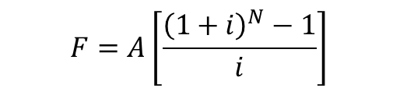
Engineering Economics
단순이자(단리)/복합이자(복리)의 차이
단순이자(simple interest): 이자계산기간에 원금에 대해서만 이자 발생
복합이자(compound interest): 매 이자계산기간의 이자를 직적기간 말에 누적된 총액에 기초하여 계산 …
기본 원리 (P/F/A)
P (현재가치)
F (미래가치)
A (동일자금열)
$$F=A{(1+i)}^{N−1}+A{(1+i)}^{N−2}+…+A\left(1+i\right)+A$$
$$(1+i)F=A{(1+i)}^{N}+A{(1+i)}^{N−1}+…+A\left(1+i\right)$$
$$F=A\left[\frac{{\left(1+i\right)}^{N}−1}{i}\right]$$

Slide 9

Engineering Economics
예제 1 (Equivalent Present Value)
만약 5년 후에 확실히 3,000만원을 받거나, 지금 P원을 받을 수 있는 두 가지 대안이 있다고 가정하자. 만일 지금 P원을 받는 경우, 연 8%의 이자율을 갖는 은행계좌에 적립할 수 있다고 가정한다면, 5년 후에 3,000원만원을 받을 수 있는 약속과 지금 P원이 동일하게 되는 P값은 얼마여야 하는가?
Sol)
$$F=P{(1+i)}^{N}$$

Slide 10
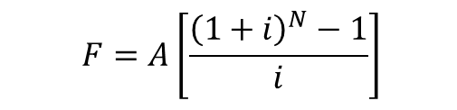
Engineering Economics
예제 2 (Equivalent Annual Value)
지금부터 5년 동안 매년 말 5,000만원씩을 예금계좌에 적립하기로 하였다. 만일 이 예금계좌의 이자율이 연 6%라고 하면, 5년 말에는 얼마를 찾을 수 있겠는가?
Sol)
$$F=A\left[\frac{{\left(1+i\right)}^{N}−1}{i}\right]$$

Slide 11
Introduction to Optimization Models & Solution Procedures
Mathematical Programming (Constrained Optimization)
Calculus-based methods: ex. Lagrange multipliers
Dynamic programming
Quadratic programming
Fractional programming
Geometric programming
HIGHLY DEPENDENT on the mathematic structure of the model (= dependent on how the system is formulated)
People tend to construct models in a way that will allow them to use a particular optimization technique they think is best

Slide 12
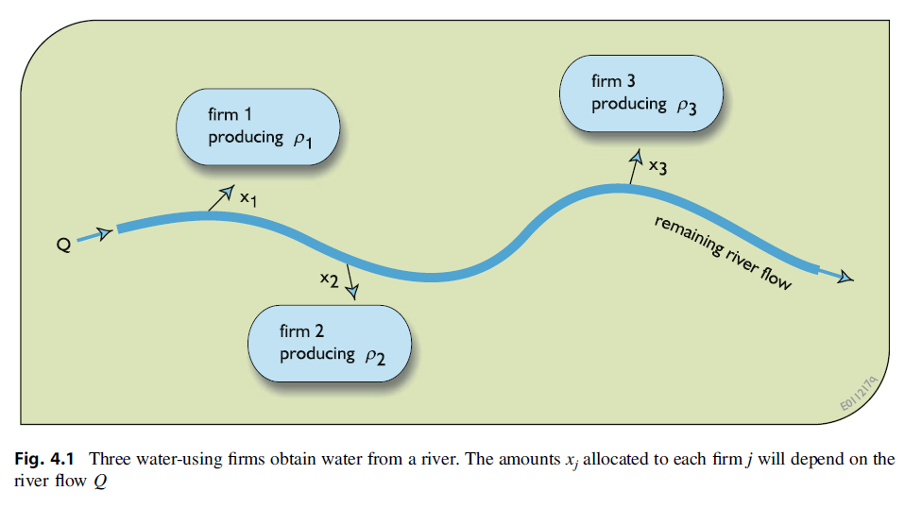
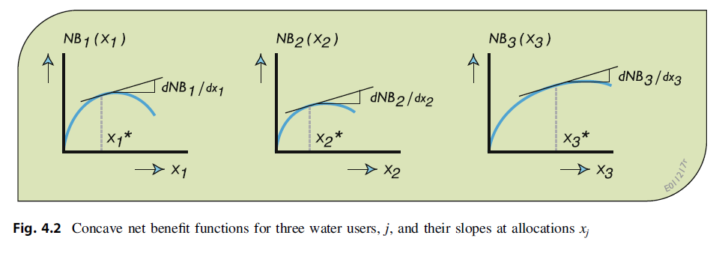
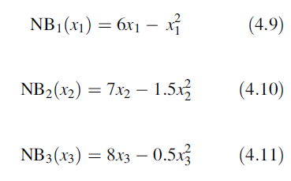
Nonlinear Optimization Model: Example

Slide 13

Nonlinear Optimization Model: Example
Approach #1: Solution Using Calculus
What are Optimal values of x1, x2, and x3? Provide answers by solving the problem using calculus.
$x_{1}=3$
$x_{2}=2.33$
$x_{3}=8$
$x_{1}+x_{2}+x_{3}=13.33$
What if $x_{1}+x_{2}+x_{3}≤8$?

Slide 14
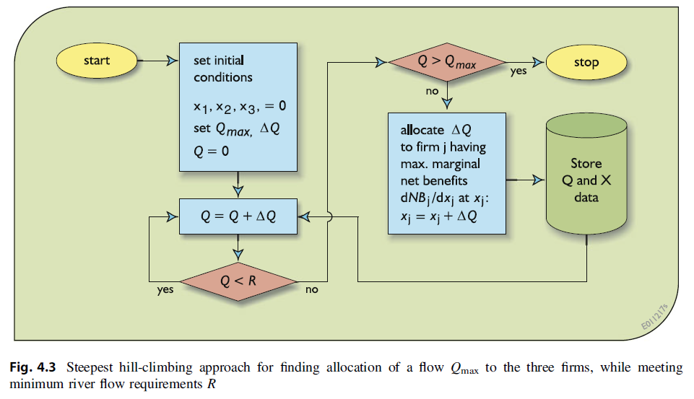
Nonlinear Optimization Model: Example
Approach #2: Solution Using Hill Climbing
What are Optimal values of x1, x2, and x3? Provide answers by solving the problem using the hill climbing method.

Slide 15
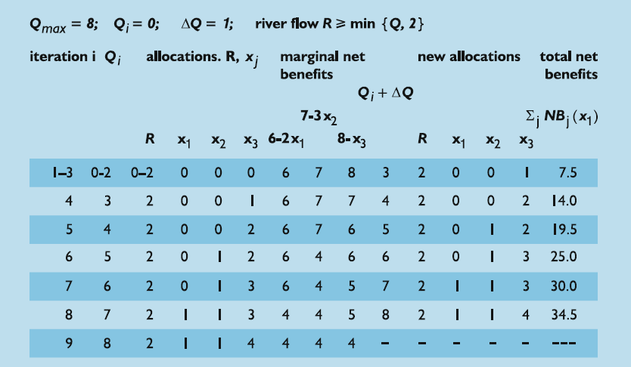
Nonlinear Optimization Model: Example
Approach #2: Solution Using Hill Climbing
What are Optimal values of x1, x2, and x3? Provide answers by solving the problem using the hill climbing method.

Slide 16
Nonlinear Optimization Model: Example
Approach #2: Solution Using Hill Climbing
What are Optimal values of x1, x2, and x3? Provide answers by solving the problem using the hill climbing method.
Limitations?
-> ONLY leads to optimal allocations only if ALL of the net benefit functions whose sum is being maximized are concave
(=marginal net benefits decrease as the allocation increases)
Otherwise, only a local optimum is guaranteed.
(true in all calculus-based optimization procedure/algorithm)

Slide 17
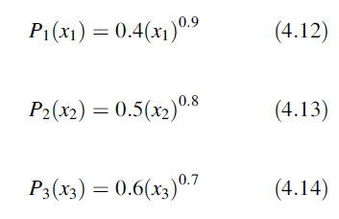
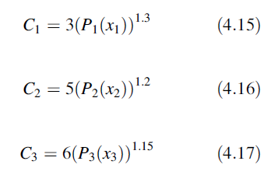
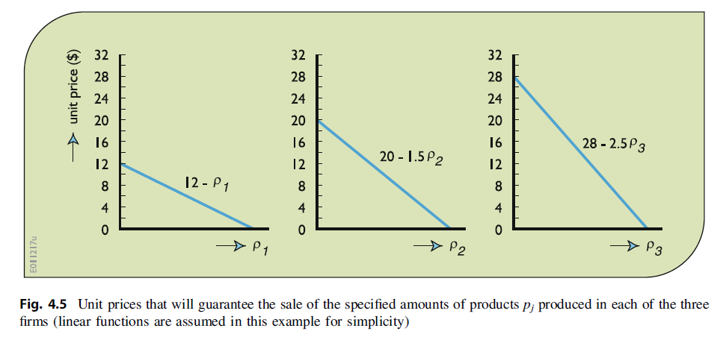

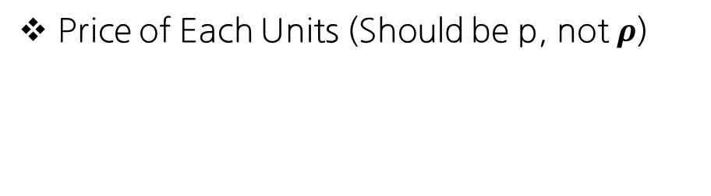
Lagrange Multiplier $λ$: Example
Production Functions P(x)
Cost Functions C
Price of Each Units (Should be p, not $ρ$)

Slide 18
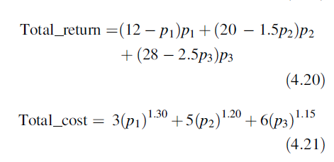
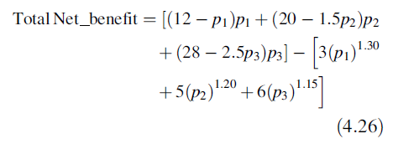
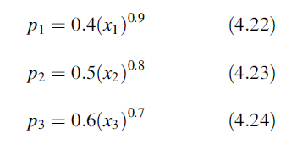

Lagrange Multiplier $λ$: Example
Objective: Maximize Net Benefit (Net Benefit = Total Return – Total Cost)
Subject to

Slide 19
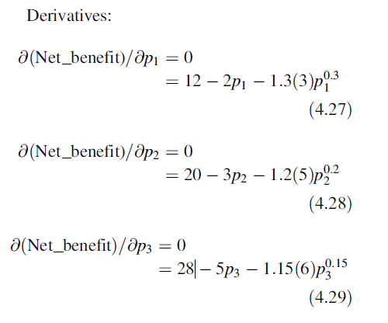
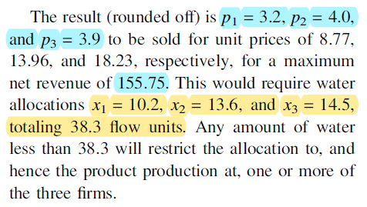
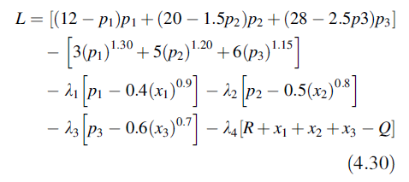


Lagrange Multiplier $λ$: Example Sol.
First, in case of an unconstrained case,
Solving with Lagrange Multipliers $λ$
1) Set up the Lagrange function L(X, $λ$)

Slide 20
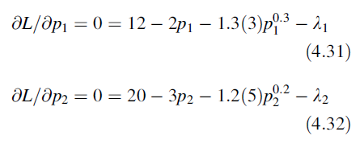
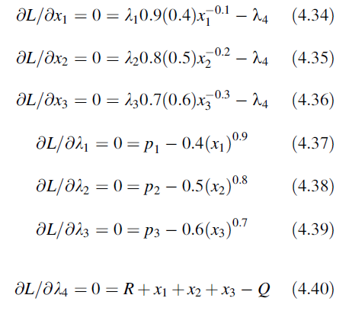


Lagrange Multiplier $λ$: Example Sol.
Solving with Lagrange Multipliers $λ$
2) Differentiate the Lagrange function L(X, $λ$) with respect to ten unknowns and set the resulting equations to 0:
LINGO, www.LINDO.com

Slide 21
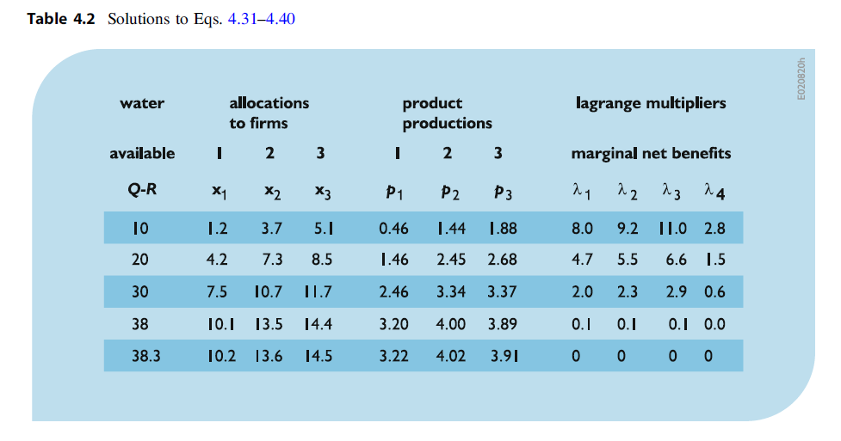

Lagrange Multiplier $λ$: Example Sol.
Solving with Lagrange Multipliers $λ$

Slide 22

Lagrange Multiplier $λ$: General Form
Notes:
Explain on Blackboard with the equations in pg.104 (4.41-4.46)

Slide 23
Lagrange Multiplier $λ$: General Form

Slide 24
Lagrange Multiplier $λ$: General Form

Slide 25
Lagrange Multiplier $λ$: General Form

Slide 26
Example with Lagrange Multipliers
Solve Exercise 4.13 in the Primary Textbook p.166-167.

Slide 29
Conclusion of Lecture 03
Engineering Economics: Time Streams of Economic Benefits & Costs
Solving Nonlinear Optimization Models with Calculus
Solution Using Calculus
Solution Using Hill Climbing
Solution Using the Lagrange Multiplier
Concepts of Dynamic Programming Models (DP)
Examples of Problem Solving with DP Models
Concepts of Linear Programming Models (LP)
Real-world Applications of Traditional Optimization Models

Slide 30
Future Schedule
다음 주 강의 (2022-03-29 화요일 17:00-19:50)
Lec 03: Introduction to Conventional Optimization Models (DP&LP) Part II
Engineering Economics: Time Streams of Economic Benefits & Costs
Solving Nonlinear Optimization Models with Calculus
Solution Using Calculus
Solution Using Hill Climbing
Solution Using the Lagrange Multiplier
Concepts of Dynamic Programming Models (DP)
Examples of Problem Solving with DP Models
Concepts of Linear Programming Models (LP)
Real-world Applications of Traditional Optimization Models
Quiz #1 on Mar-29 // Datacamp #1 Due Mar-29

